Slide 1
23ECE498 – PROJECT PHASE I
EVALUATION I
Design of an Efficient FPGA-Oriented FFT Framework Employing Quartic Polynomial Estimation for RF Applications
TEAM: B057
Dheeraj Reddy B BL.EN.U4ECE23112
Vaibhavi C R BL.EN.U4ECE23152
Name of the Guide: Dr. Parul Mathur
Name of the Evaluator:
Dr. Ashish Goswami
Mr. Swaminadhan Rajula

Slide 2
INTRODUCTION
Modern RF systems require efficient processing and analysis of signals in the frequency domain.
The Fast Fourier Transform (FFT) is widely used to convert signals from the time domain into the frequency domain.
FFT significantly reduces the computational complexity compared with direct Discrete Fourier Transform (DFT) computation.
Two-Dimensional FFT (2D FFT) extends frequency-domain analysis to two-dimensional data.
FFT processing is useful in applications involving multidimensional signal analysis, imaging, beamforming, and spectral processing.
FPGA platforms provide parallel processing capability, high throughput, and reconfigurability, making them suitable for real-time signal-processing applications.
This project focuses on developing an FPGA-oriented 2D FFT framework integrated with Quartic Polynomial Estimation for RF applications.

Slide 3
MOTIVATION
RF applications require accurate and fast frequency analysis.
Conventional implementations can have high computational complexity.
Real-time processing requires low latency and high throughput.
FPGA provides parallelism and efficient hardware implementation.
Frequency estimation becomes challenging for signals containing multiple sinusoidal components.
There is a need for an optimized framework that combines efficient FFT processing with Quartic Polynomial Estimation.
PROBLEM STATEMENT
RF signal analysis requires accurate and computationally efficient spectral processing. Implementing 2D FFT and frequency-estimation techniques on FPGA involves challenges such as:
High computational complexity
Hardware resource utilization
Memory requirements Processing latency
Timing constraints
Therefore, an optimized and modular FPGA-oriented framework is required to perform efficient 2D FFT processing and accurate frequency estimation for RF signal analysis.

Slide 4
Sub-Objective
OBJECTIVE
To design and mathematically optimize a Quartic Polynomial Estimator-based Two-Dimensional Fast Fourier Transform algorithm for FPGA implementation, enabling efficient and accurate spectral analysis of RF signals and establishing the foundation for a high-performance VLSI architecture.
Study the mathematical principles of 2D FFT and QPE.
Optimize the algorithm for FPGA implementation.
Design modular FPGA-compatible functional blocks.
Verify the algorithm using sinusoidal test signals.
Perform fixed-point and timing analysis.
Develop a scalable framework for future real-time RF applications.

Slide 5
LITERATURE SURVEY
Paper 1: “A Quartic Polynomial Based Approach for Multi-Sinusoidal Frequency Estimation” — G. Narayanan and D. G. Kurup — International Journal of Electrical and Electronic Engineering & Telecommunications, 2024
Proposed a Quartic Polynomial-based approach for estimating frequencies in multi-sinusoidal signals.
The method focuses on improving frequency estimation by using polynomial-based mathematical analysis.
It is relevant to RF signal processing, where accurate identification of frequency components is important.
Key Results:
Demonstrated the applicability of Quartic Polynomial Estimation for multi-sinusoidal frequency estimation.
Provided a mathematical approach for analysing and estimating signal frequencies.
Established QPE as a potential technique for improving spectral and frequency analysis.
Research Gap: The work mainly focuses on the frequency estimation algorithm. Further investigation is required to integrate the approach with a 2D FFT-based, FPGA-oriented hardware architecture for real-time RF applications.

Slide 6
LITERATURE SURVEY
Paper 2: “FPGA Implementation of Efficient 2D-FFT Beamforming for On-Board Processing in Satellites” — R. Palisetty, G. Eappen, V. Singh, and L. M. Garces Socarras — IEEE VTC-Fall, 2023
Proposed an efficient FPGA-based implementation of 2D FFT for beamforming applications.
The work demonstrates the importance of FPGA platforms for computationally intensive multidimensional signal processing.
The architecture is relevant to applications requiring efficient and high-speed processing.
Key Results:
Demonstrated the feasibility of implementing efficient 2D FFT processing on FPGA.
Showed the importance of hardware-oriented optimization for high-performance signal processing.
Provided insights into the implementation of 2D FFT for real-time applications.
Research Gap: The work focuses on 2D FFT beamforming. There is an opportunity to investigate the integration of Quartic Polynomial Estimation with 2D FFT processing for frequency estimation and RF spectral analysis.

Slide 7
LITERATURE SURVEY
Paper 3: “Implementation of a Two-Dimensional FFT/IFFT Processor for Real-Time High-Resolution Synthetic Aperture Radar Imaging” — H.-Y. Chin, P.-Y. Tsai, and S.-Y. Lee — IEEE SiPS, 2021
Presented a 2D FFT/IFFT processor for real-time high-resolution Synthetic Aperture Radar applications.
The work focuses on efficient hardware processing of two-dimensional transform operations.
It highlights the importance of architecture design for real-time, high-performance signal processing.
Key Results:
Demonstrated the implementation of a 2D FFT/IFFT processor for real-time applications.
Showed the importance of efficient processing architecture in reducing computational bottlenecks.
Provided architectural insights for designing high-performance multidimensional FFT systems.
Research Gap: The work is focused on SAR imaging applications. Further work can investigate an optimized FPGA architecture specifically targeting RF spectral analysis and frequency estimation using QPE.

Slide 8
LITERATURE SURVEY
Paper 4: “FPGA Architecture for 2D Discrete Fourier Transform Based on 2D Decomposition for Large-Sized Data” — J. S. Kim et al. — IEEE SiPS, 2009
Proposed an FPGA architecture for implementing 2D Discrete Fourier Transform using 2D decomposition.
The work addresses the processing of large-sized two-dimensional data.
It provides insights into decomposition techniques and hardware organization for multidimensional transform processing.
Key Results:
Demonstrated an FPGA-oriented architecture for large-sized 2D transform processing.
Showed the usefulness of 2D decomposition in organizing multidimensional computations.
Provided insights into scalable architecture and hardware resource management.
Research Gap: The work primarily addresses the implementation of 2D DFT using decomposition techniques. Further research can focus on combining efficient 2D FFT processing with Quartic Polynomial Estimation and optimizing the complete system for RF applications.

Slide 9
LITERATURE SURVEY SUMMARY
Paper Title | Problem Addressed | Methodology | Final Outcome | Gaps Identified
A Quartic Polynomial Based Approach for Multi-Sinusoidal Frequency Estimation | Accurate frequency estimation of signals containing multiple sinusoidal components. | Developed a Quartic Polynomial Estimation (QPE) approach for estimating sinusoidal frequencies through polynomial-based mathematical analysis. | • Demonstrated a quartic polynomial-based approach for multi-sinusoidal frequency estimation. • Provided a mathematical basis for accurate frequency estimation. | • Focuses mainly on the estimation algorithm. • Does not specifically address integration with a complete 2D FFT-based FPGA architecture. • Hardware resource and real-time implementation aspects require further study.
FPGA Implementation of Efficient 2D-FFT Beamforming for On-Board Processing in Satellites | Efficient implementation of computationally intensive 2D FFT processing for beamforming applications. | Implemented an efficient 2D FFT-based beamforming architecture on FPGA for high-performance on-board processing. | • Demonstrated the feasibility of FPGA-based 2D FFT processing. • Showed the importance of efficient hardware architecture for high-speed signal processing. | • Focused specifically on satellite beamforming. • Does not focus on Quartic Polynomial Estimation. • Further work is needed for integrating frequency estimation with 2D FFT for RF spectral analysis.
Implementation of a Two-Dimensional FFT/IFFT Processor for Real-Time High-Resolution Synthetic Aperture Radar | Real-time processing requirements for high-resolution SAR imaging using 2D FFT/IFFT operations. | Designed and implemented a 2D FFT/IFFT processor architecture suitable for real-time high-resolution processing. | • Demonstrated a hardware-oriented 2D FFT/IFFT processing approach. • Established the importance of efficient architecture for real-time multidimensional. | • Application is focused on SAR imaging. • Does not address Quartic Polynomial-based frequency estimation. • RF-specific spectral estimation and QPE integration remain opportunities for further investigation.
FPGA Architecture for 2D Discrete Fourier Transform Based on 2D Decomposition for Large-Sized Data | Efficient FPGA implementation of large-sized 2D Discrete Fourier Transform operations. | Proposed an FPGA architecture based on 2D decomposition to organize and process large-sized multidimensional data. | • Demonstrated an FPGA-oriented architecture for large-sized 2D transform processing. • Showed the usefulness of decomposition for scalable multidimensional computation. | • Focuses on 2D DFT architecture rather than QPE-based frequency estimation. • Further optimization can investigate FFT-based implementations and FPGA resource efficiency. • Does not address integration with RF frequency estimation.

Slide 10
Problem Statement
RF signal analysis requires accurate and computationally efficient spectral processing.
Implementing 2D FFT and frequency-estimation techniques on FPGA involves challenges such as:
High computational complexity
Hardware resource utilization
Memory requirements
Fixed-point precision
Processing latency
Timing constraints
Therefore, an optimized and modular FPGA-oriented framework is required to perform efficient 2D FFT processing and accurate frequency estimation for RF signal analysis.

Slide 11
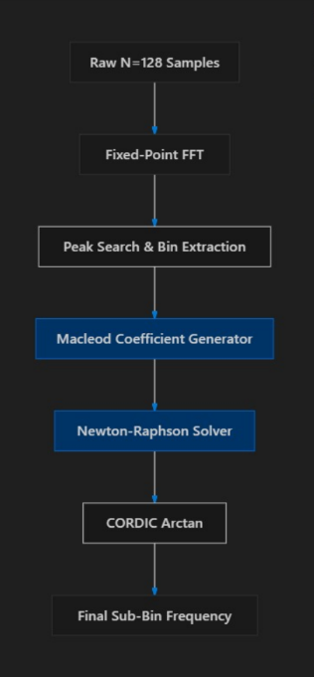
Proposed Architecture Blocks:
Input Interface
FFT Processing Unit
Arithmetic Units
Memory Buffers
QPE Processing Unit
Control Logic
Output Interface
Methodology
Study 2D FFT and QPE algorithms.
Mathematically analyse and optimize the algorithms.
Perform fixed-point analysis.
Design modular FPGA-compatible architecture.
Simulate using sinusoidal test signals.
Verify accuracy and spectral output.
Prepare the design for FPGA implementation.

Slide 12
TIMELINE
Month | Planned Work
July 2026 | Literature survey, study of 2D FFT and QPE, mathematical formulation
August 2026 | Algorithm optimization, fixed-point analysis, architecture design, initial simulation
September 2026 | Development and verification of FPGA processing blocks
October 2026 | Integration of IP blocks and system-level verification
November 2026 | Hardware validation, performance analysis, GUI development, documentation

Slide 13
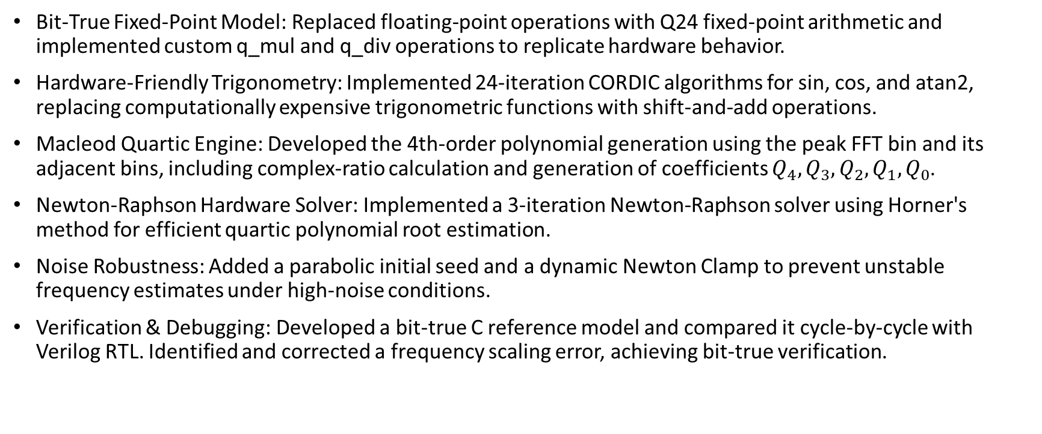
Work Done So Far…
Bit-True Fixed-Point Model: Replaced floating-point operations with Q24 fixed-point arithmetic and implemented custom q_mul and q_div operations to replicate hardware behavior.
Hardware-Friendly Trigonometry: Implemented 24-iteration CORDIC algorithms for sin, cos, and atan2, replacing computationally expensive trigonometric functions with shift-and-add operations.
Macleod Quartic Engine: Developed the 4th-order polynomial generation using the peak FFT bin and its adjacent bins, including complex-ratio calculation and generation of coefficients $Q_{4},Q_{3},Q_{2},Q_{1},Q_{0}$.
Newton-Raphson Hardware Solver: Implemented a 3-iteration Newton-Raphson solver using Horner's method for efficient quartic polynomial root estimation.
Noise Robustness: Added a parabolic initial seed and a dynamic Newton Clamp to prevent unstable frequency estimates under high-noise conditions.
Verification & Debugging: Developed a bit-true C reference model and compared it cycle-by-cycle with Verilog RTL. Identified and corrected a frequency scaling error, achieving bit-true verification.

Slide 14
REFERENCES
G. Narayanan and D. G. Kurup, “A Quartic Polynomial Based Approach for Multi-Sinusoidal Frequency Estimation,” International Journal of Electrical and Electronic Engineering & Telecommunications, 2024.
R. Palisetty et al., “FPGA Implementation of Efficient 2D-FFT Beamforming for On-Board Processing in Satellites,” IEEE VTC-Fall, 2023.
H.-Y. Chin, P.-Y. Tsai, and S.-Y. Lee, “Implementation of a Two-Dimensional FFT/IFFT Processor for Real-Time High-Resolution Synthetic Aperture Radar Imaging,” IEEE SiPS, 2021.
J. S. Kim et al., “FPGA Architecture for 2D Discrete Fourier Transform Based on 2D Decomposition for Large-Sized Data,” IEEE SiPS, 2009.

